Slide 1
Money Corp Employee Retention Analysis
DDSAnalytics - Talent Management Solutions
Redwood Group 2019

Slide 2
Business Summary
Analysis Contracted by - DDS Analytics
Analysis Contracted for - Money Corp (a fortune 1000 company)
Analysis Preformed by – Redwood Group

Slide 3
Redwood Group
Pankaj Kumar
Daniel Turner
Kay Ayala
Redwood Group 2019

Slide 4
Over View
Business Objectives
Data Sourced
Methodology
Evaluation/Results
Summary
Redwood Group 2019

Slide 5
Objectives
What factors contribute to employee retention?
What trends exist for different job roles?
Redwood Group 2019

Slide 6
Data
Money Corp Employee History provided by DDSAnalytics
1471 Anonymized Employees
35 Metrics
Age Gender Role Income Education etc.
Redwood Group 2019

Slide 7
Basic Statistics
Historical rate of attrition 16%
Total number of job roles 9
Median monthly income $4,919
Median distance from home 9 miles
Median job satisfaction high
Redwood Group 2019

Slide 8
Methodology
Steps & Workflow
Graphically Investigated Data
Correlation Plots
Modeling Data
Redwood Group 2019

Slide 9
Evaluation & Results
Job Role Investigation
Other Trends in Overall Data
Attrition Investigation

Slide 10
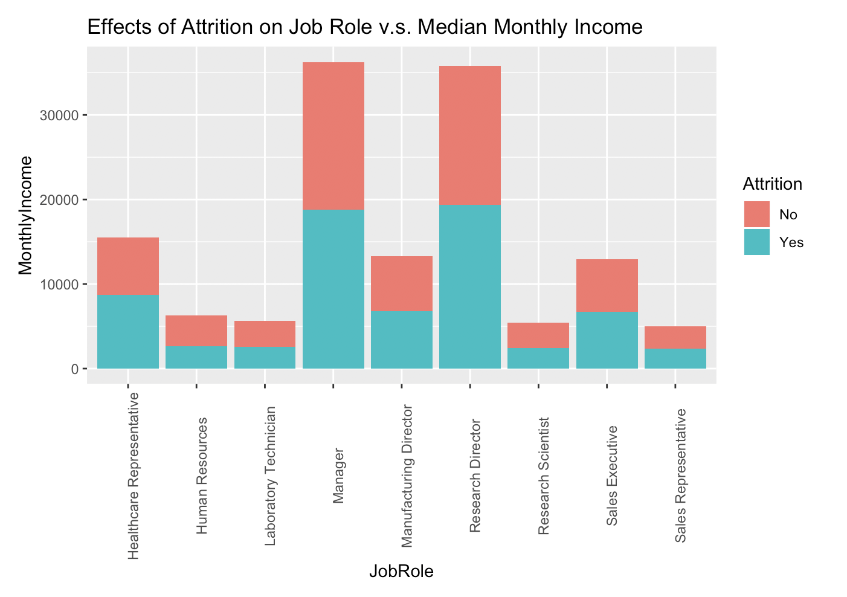
Job Role
Redwood Group 2019

Slide 11
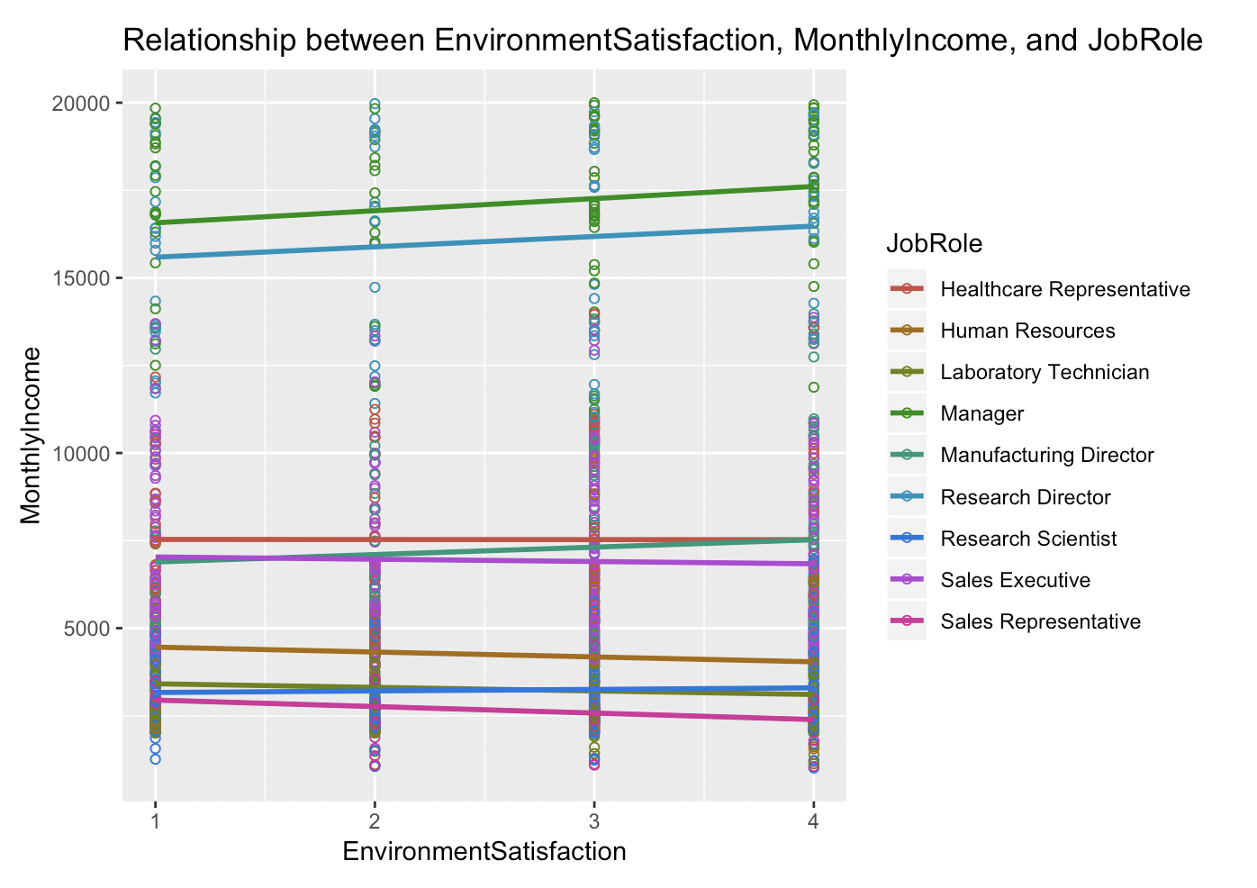
Job Role

Slide 12
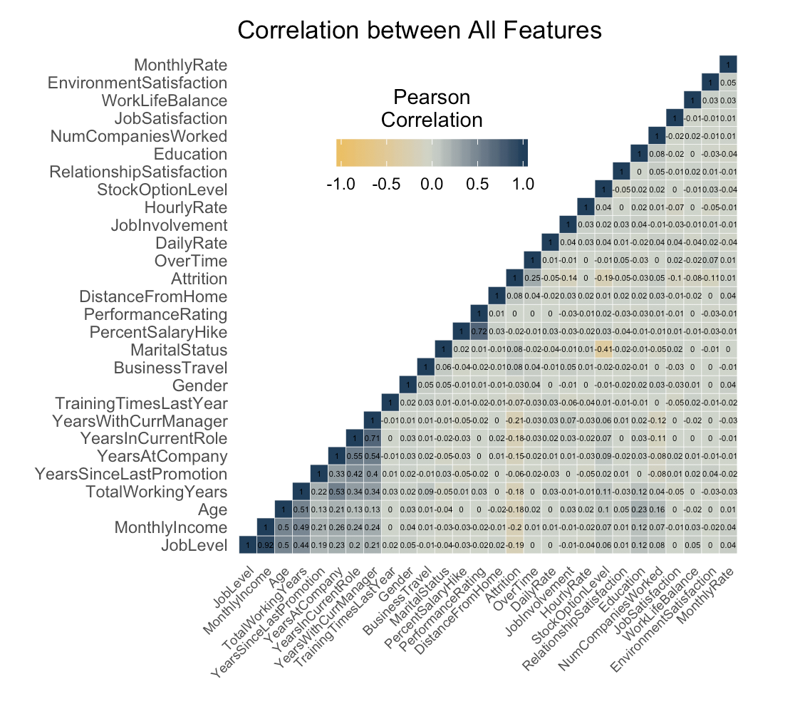
Other Trends

Slide 13
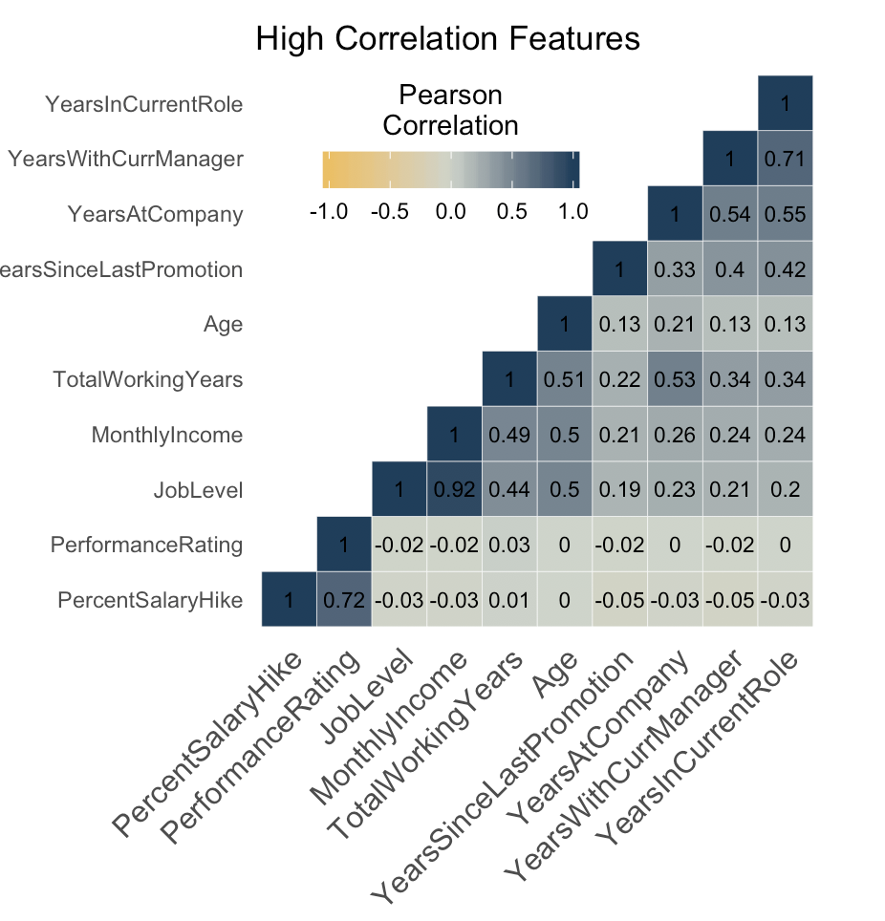
Other Factors

Slide 14
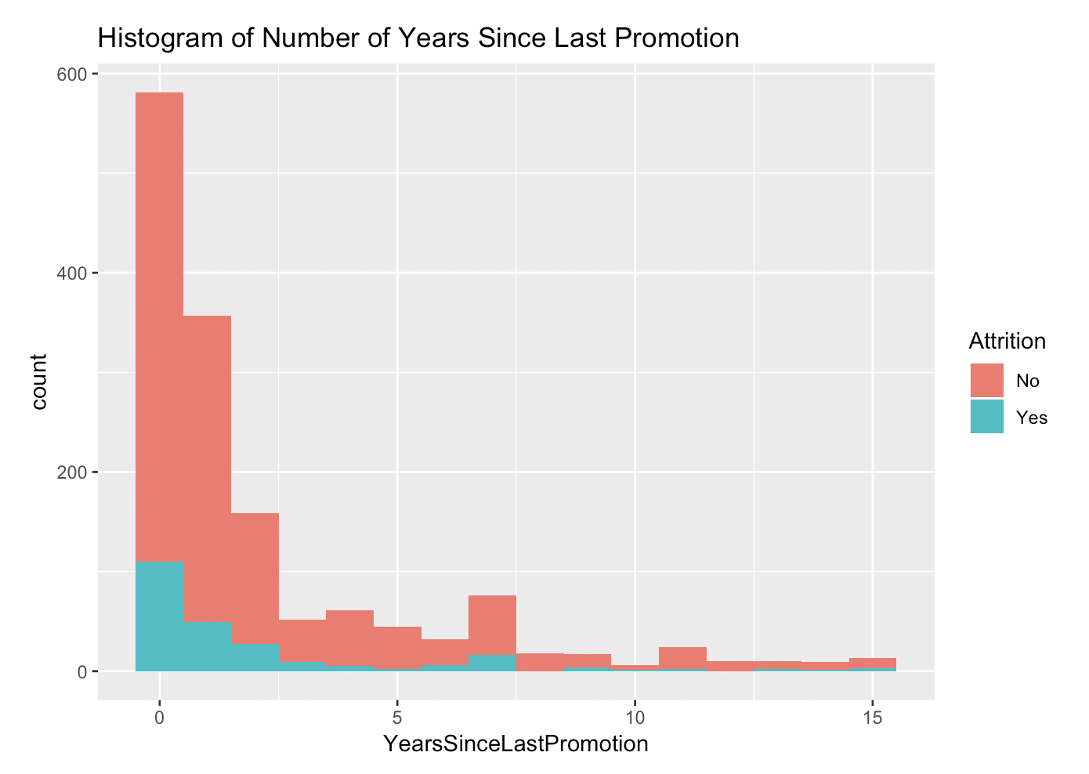
Other Trends

Slide 15
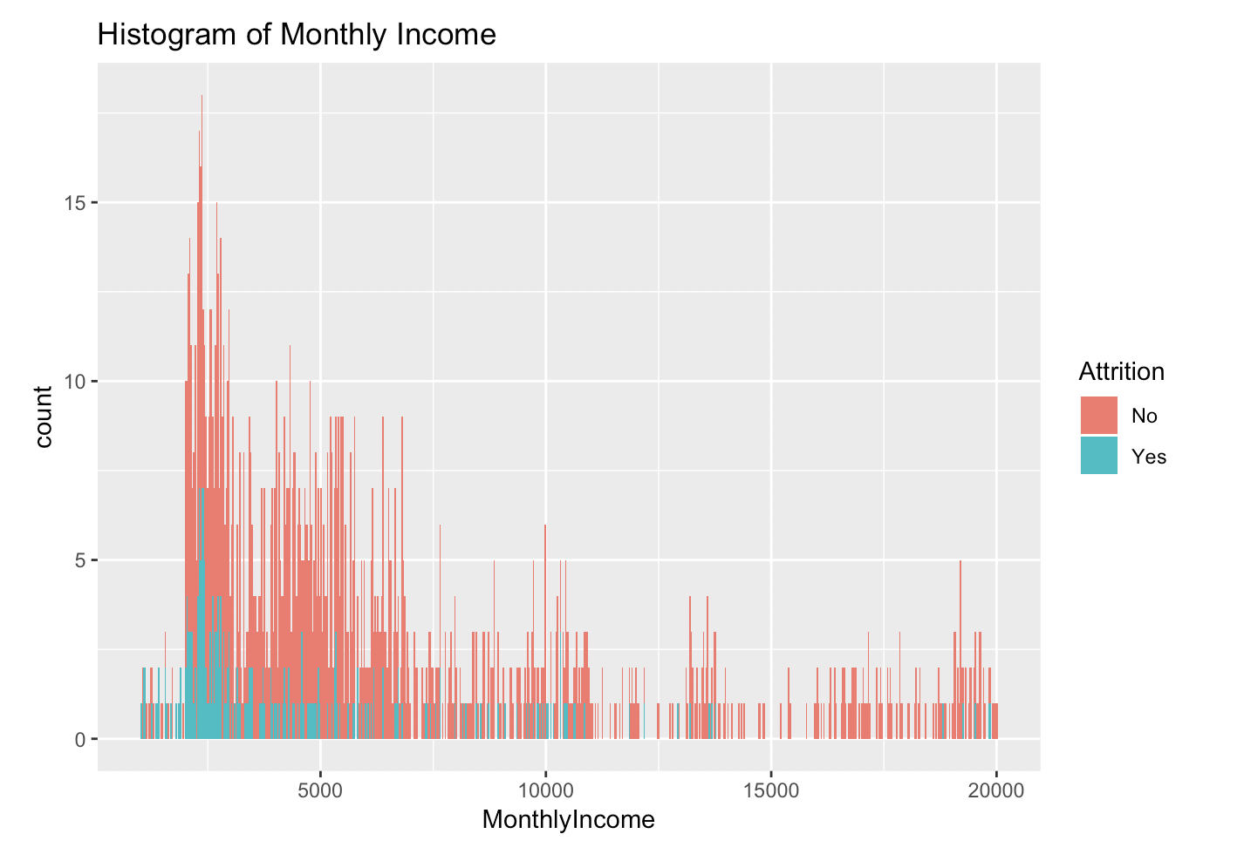
Other Trends

Slide 16
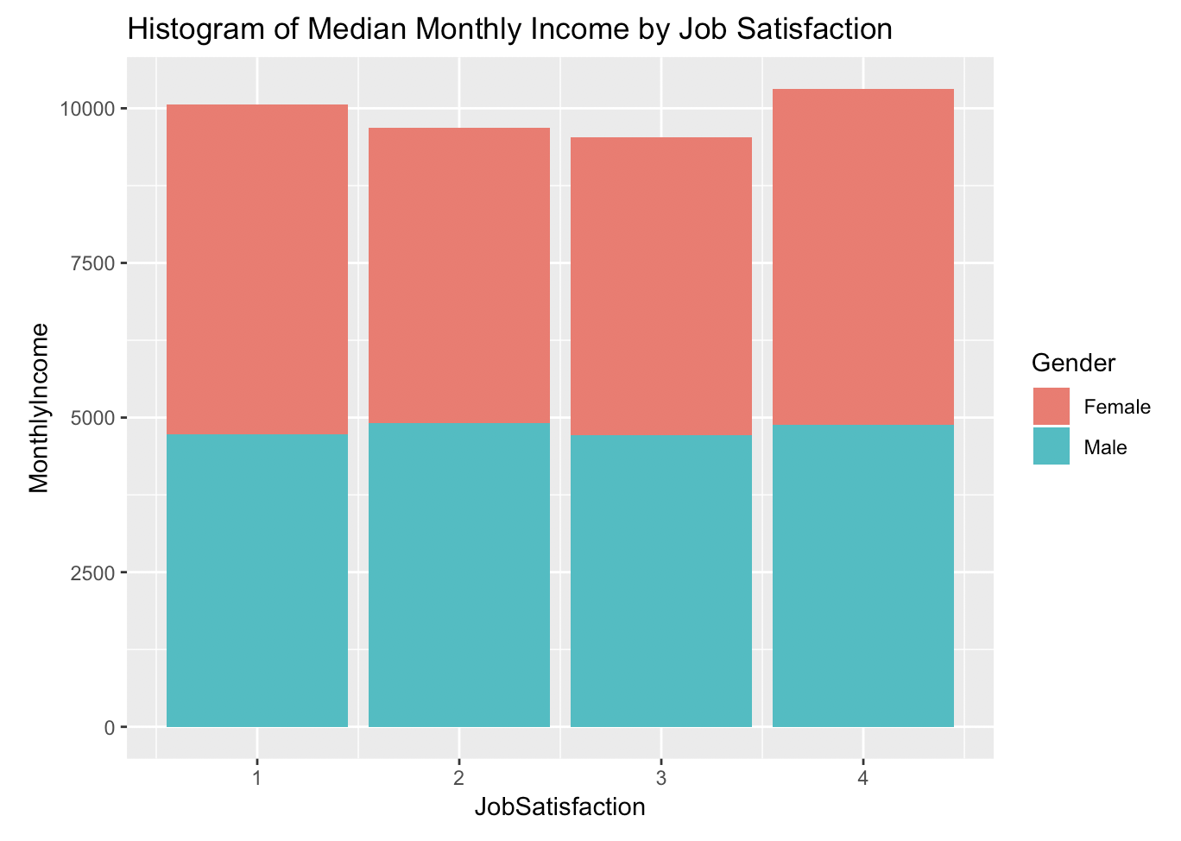
Other Trends
.
Redwood Group 2019

Slide 17
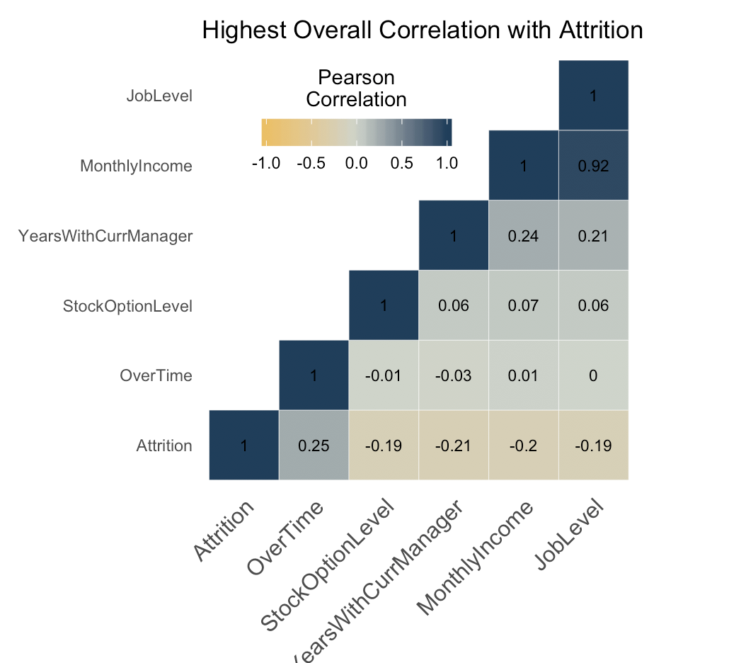
Top Attrition Factors

Slide 18
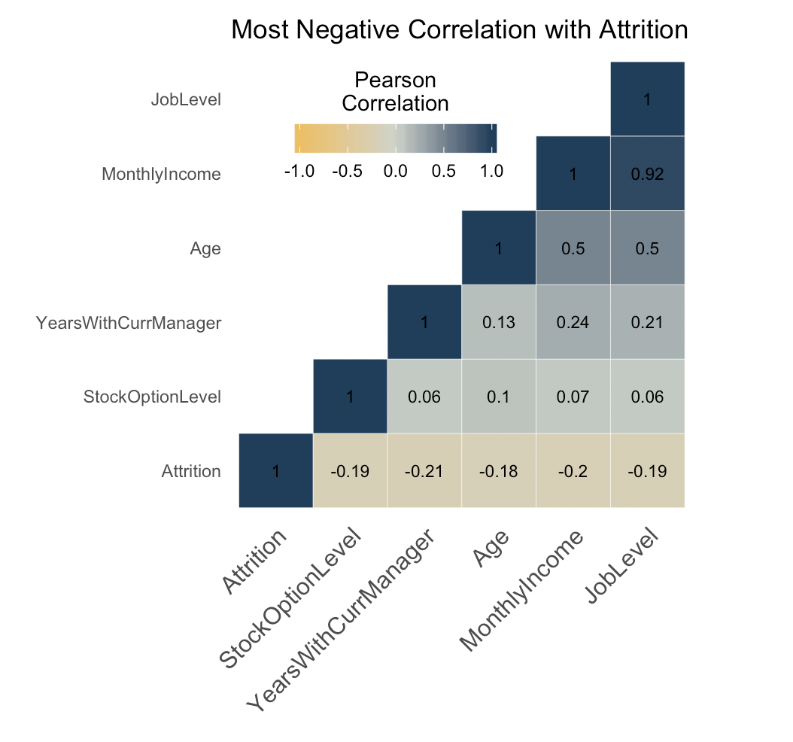
Top Attrition Factors

Slide 19
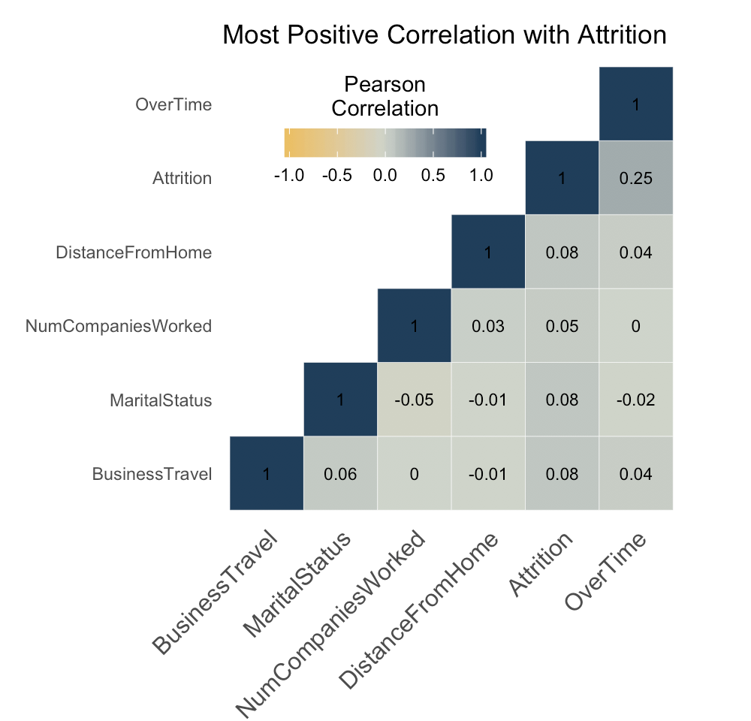
Top Attrition Factors

Slide 20
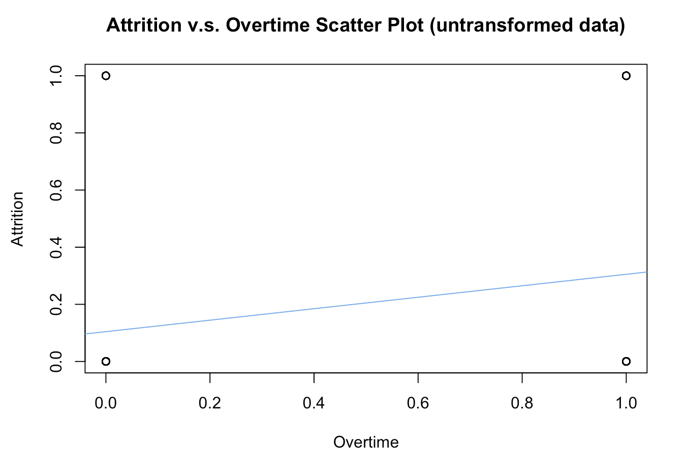
Top Factors

Slide 21
Top Factors
Linear model of the top three features
Over time
Years with current manager
Monthly income
Attrition = 1.139679 + 0.016614*log(OverTime) - 0.009771*log(Manager) - 0.095478*log(MonthlyIncome)
All parameter estimates were significant
Resulted in 87% correct classification

Slide 22
Top Factors
K Nearest Neighbors Model
Predicting Attrition from
Age, JobSatisfaction, MonthlyIncome,
StockOptionLevel, DistanceFromHome,
JobLevel, YearsAtCompany,
TotalWorkingYears, YearsWithCurrManager
Resulted in 80% correct classification

Slide 23
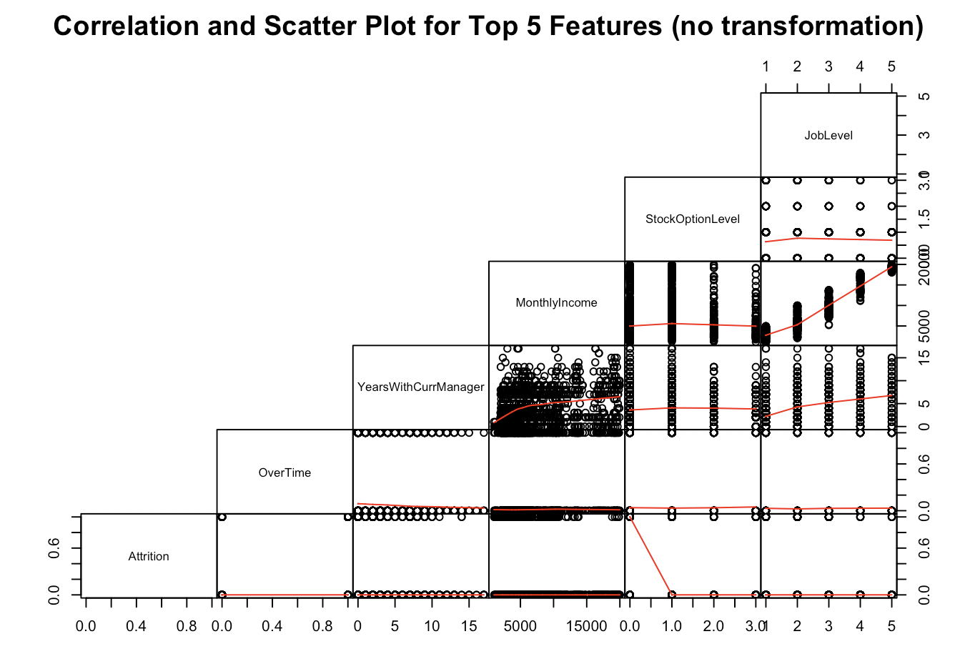
Future Analyses
If Money Corp is interested in building an attrition prediction model categorial classification methods would be more suited to this data.
Why?
Both attrition and many other features in the data are categorical. This is not well suited to linear regression.

Slide 24
Questions?
Redwood Group 2019

